Slide 1
Chapter: Protection and Security

Slide 2
Objectives
Discuss the goals and principles of protection in a modern computer system
Explain how protection domains combined with an access matrix are used to specify the resources a process may access
Examine capability and language-based protection systems

Slide 3
Goals of Protection
Process in OS must be protected from the one another.
Protection refers to a mechanism for controlling the access of the programs, processes or users to the resources defined by the computer system.
Protection improves reliability.
Protection Mechanism determine: how some thing will be done
Policy determine: what is to be done.
Protection refers to a mechanism for controlling the access of programs, processes, or users to the resources defined by a computer system.
This mechanism must provide a means for specifying the controls to be imposed, together with a means of enforcement.

Slide 4
Security
Method of protecting information stored in the system from un-authorized access.
Security must consider external environment of the system, and protect it from:
  unauthorized access.
  malicious modification or destruction
  accidental introduction of inconsistency.
Security violation can be categorized as intentional or accidental.
Security is a measure of confidence that the integrity of a system and its data will be preserved.

Slide 5
Some Security Violations
Breach of Confidentiality: Unauthorized reading of data. Theft of information
Breach of integrity: Unauthorized modification of data.
Breach of availability: Unauthorized destruction of data/ website defacement:
A website defacement is an attack on a website that changes the visual appearance of the site or a webpage.
Theft of service: Unauthorized use of resources.
Denial of service: Send invalid data to applications or network services, which cause abnormal termination.
Flood a computer or the entire network with traffic until a shutdown occurs because of the overload and new request by the authorized user will not be fulfilled. .

Slide 6
Security Measure Levels
To protect our system, we must take security measures at 4 levels:
Physical - Secure Hardware Components
Human – Use Passwords for protection(protect human also from phishing attack like apam mails.)
Operating system – Use Valid Login and Password
Network – Use authentication and anti-virus to protect data/ resources over the network.

Slide 7
Program Threats
Writing a program that creates a breach of security or causing a normal process to change its behavior and create a breach is the common goal of crackers
Malware: A destructive program that pretend to be a gentle application.
A back door is a means of access to a computer program that bypasses security mechanisms.

Slide 8
Program Threats
1. Trojan horse
A Trojan horse, or Trojan, is software that appears to perform a desirable function for the user, but steals information or harms the system. It’s a destructive program that looks like a genuine application. Trojan also open the backdoor entry to your computer which gives malicious user program to access the computer.
Trojan horse is a program in which harmful code is contained in such a way that it can get control and do its chosen form of damage

Slide 9
2. Spyware
A software that secretly monitors the user's computing.
Spyware is a type of malware that can be installed on computers, and which collects small pieces of information about users without their knowledge.
The presence of spyware is typically hidden from the user, and can be difficult to detect.
Sometimes, Spywares are installed by the owner of a shared, corporate, or public computer in order to secretly monitor other users.

Slide 10
2. Spyware
Spyware sometimes accompanies a program that the user has chosen to install.
The goal of spyware is to download ads to display on the user’s system, create pop-up browser windows when certain sites are visited, or capture information from the user’s system and return it to a central site.

Slide 11
3. Trap Door
The designer of a program or system might leave a hole in the software that only designer is capable of using. This type of security breach is called trap door.
For instance, the code might check for a specific user ID or password, and it might circumvent normal security procedures
A clever trap door could be included in a compiler. The compiler could generate standard object code as well as a trap door, regardless of the source code being compiled.

Slide 12
4. VIRUS
VIRUS: Vital Information Resource Under Seize or Very Important Resource Under Seize
Self replicating, designed to harm other computers also.
Fragment of malicious code embedded in a genuine program.
designed to “infect” other programs.
Specific to architecture, operating systems and applications.
Almost all viruses are attached to the executable file means it can present in the computer without any harm to the computer but can create destruction once that executable file starts the execution.
Virus cannot travel from one host to another host. It can be spread by humans only by sharing the virus infected files.

Slide 13
System and Network Threats
Program threats typically use a breakdown in the protection mechanisms of a system to attack programs.
System and network threats involve the abuse of services and network connections.
System and network threats create a situation in which operating-system resources and user files are misused.

Slide 14
1. Worms
Self propagating.
A worm is a process that uses the spawn mechanism to duplicate itself. The worm spawns copies of itself, using up system resources and perhaps locking out all other processes.
If a device gets infected, it sends the copies of itself onto the network to other devices.
Sometimes more disturbing, it might go into your email, find your contacts, sends copies of itself to all the contacts.

Slide 15
2. Port Scanning
Port scanning is not an attack but rather a means for a cracker to detect a system’s vulnerabilities (bug) to attack.
To enter in the server it contains many ports like port 80, 25 and many. Always https is having port 80.
So, if malicious user want to enter inside the server it can enter through the port.
A port scan attack helps cyber criminals find open ports and figure out whether they are receiving or sending data. It can also reveal whether active security devices like firewalls are being used by an organization.

Slide 16
3. Denial of Service
denial-of-service attacks are aimed not at gaining information or stealing resources but rather at disrupting genuine use of a system or facility.
Denial-of-service attacks are generally network based.
They fall into two categories:
1. Attacks in the first category use so many facility resources that, in essence no useful work can be done.
2. The second category involves disrupting the network of the facility.

Slide 17
Authentication
Process of verifying the identity of user or information
1. User Authentication
  Process of verifying the identity of user when user logs into a computer system.
  Main Objective: Allow authorized users to access the computer.
  Authentication Process consists of 2 steps:
  Identification Step
  Verification Step

Slide 18
Measures of Authentication
False Acceptance Ratio: % of unauthorized users incorrectly entered the system
False Rejection Ratio: % of authorized users that fails to access the system due to failure of authentication.

Slide 19
General Methods of Authentication
Include a Password
Include electronic key or smart cards
Static Biometric – Recognition by finger print, retina or face.
Dynamic Biometric – Recognition by Voice, Handwriting or Typing Pattern.

Slide 20
Password Verification
Password Verification – Authentication Mechanism
Password- a secret text that is supposed to be known only to users.
System allows authorized users who have valid user name and password to access the system.

Slide 21
Access Control
Method that determines:
  What types of access are permitted on different resources
  Under what circumstances
  By Whom

Slide 22
Access Control
Access Control Model has 3 basic components:
  Subjects (S) or Domain: Represents a finite set of entities that have access to current object.
    Subject may be: User , Process or Procedure
  Objects (O): Represents a finite set of resources that need access.
    Object may be: H/w device ( processor, memory) Or S/W resources ( page table, files etc)
  Rights ( R): Represents a finite set of Operations that a Subject can perform on Object.

Slide 23
Access Matrix
Discretionary Access Control Model is represented by Access Matrix.
It is used to describe which users have access to what objects or resources.
Access Matrix consists of Rows and Columns
Rows represent : Current Subject / Domain
Column represent: Current Object

Slide 24
Discretionary Access Control/ Access Matrix
View protection as a matrix (access matrix)
Rows represent domains
Columns represent objects
Access(i, j) is the set of operations that a process executing in Domain_{i} can invoke on Object_{j}

Slide 25

Access Matrix

Slide 26
Use of Access Matrix
If a process in Domain D_{i} tries to do “op” on object O_{j}, then “op” must be written in the access matrix
Can be expanded to dynamic protection
  Operations to add, delete access rights
  Special access rights:
    owner of O_{i}
    copy op from O_{i} to O_{j}
    control – D_{i} can modify D_{j} access rights
    transfer – switch from domain D_{i} to D_{j}

Slide 27
Use of Access Matrix (Cont)
Access matrix design separates mechanism from policy
  Mechanism (Method)
    Operating system provides access-matrix + rules
    If ensures that the matrix is only manipulated by authorized agents and that rules are strictly enforced
  Policy (Rules)
    User dictates policy
    Who can access what object and in what mode

Slide 28
Implementation of Access Matrix
There are 2 methods:
1. Access Control Lists
  ACL can be created by dividing Access Matrix Column Wise.
  Separate list is maintained for each domain and each object.
  It skips blank row entries in each domain.
2. Capability List
  Can be created by dividing Access Matrix Row Wise.
  It is list of access rights that a user / domain or a process has for a object.
  It is divided into 2 fields:
    Object Descriptor
    Access Rights

Slide 29
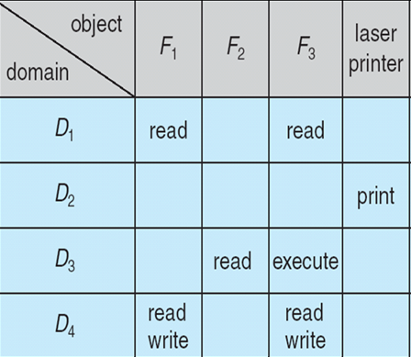
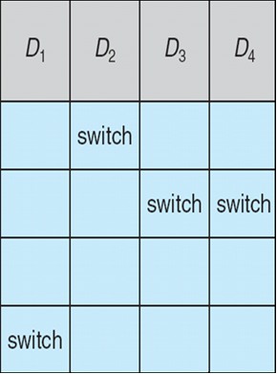
Access Matrix With Domains as Objects
Figure B

Slide 30

Operation on Access Matrix Entries
1. Copy
  It allows the access right to be copied only within the column (for an object)
  Ability to copy an access right from one domain (row) to another is denoted by asterisk ( * )
  A process executing in domain D2 can copy read operation into any entry associated with file F2
  The ability to copy rights is denoted by an asterisk, indicating that processes in that domain have the right to copy that access within the same column

Slide 31
Access Matrix with Copy Rights
For example, in Figure
(a), a process executing in domain D2 can copy the read operation into any entry associated with file F2.
Hence, the access matrix of Figure (a) can be modified to the access matrix shown in Figure(b).

Slide 32
Operation on Access Matrix Entries
2. Owner
  It allows addition or removal of access rights.
  If any access includes owner right then a process executing in domain Di can add or remove any access right in entry of that column.
Copy and Owner allow a process to change the entry in column.
If access(i, j) includes the owner’s right, then a process executing in domain Di can add and remove any right in any entry in column j.

Slide 33
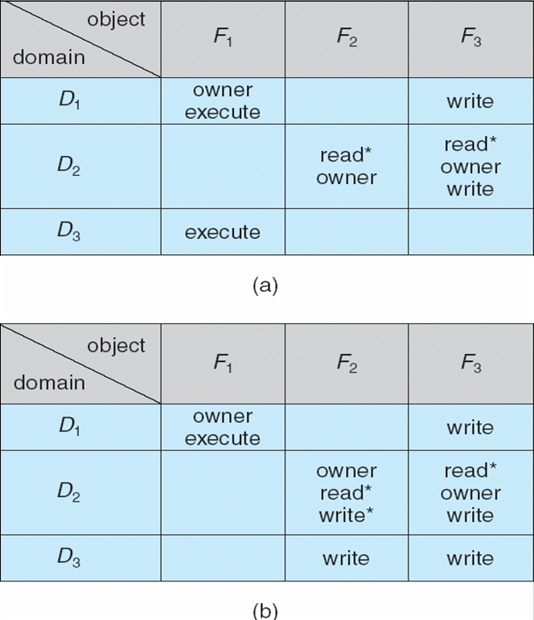
Access Matrix With Owner Rights
For example, in Figure (a), domain D1 is the owner of F1 and thus can add and delete any valid right in column F1.
Similarly, domain D2 owns F2 and F3 and thus can add and remove
any valid right within these two columns. Thus, the access matrix of Figure
(a) can be modified to the access matrix shown in Figure (b).

Slide 34

Operation on Access Matrix Entries
3. Control Right
  Control right mechanism used to change entries in a row.
  Control right is applicable only to domain objects.
  If access( i , j ) includes control right, then a process executing in domain Di can remove any access right from row j.
  Switch operation works for column only
For example, suppose that, we include the control right in access(D2, D4). Then, a process executing in domain D2 could modify domain D4, as shown.

Slide 35
Operation on Access Matrix Entries
3. Control Right
For example, suppose we include the control right in access(D2, D4). Then, a process executing in domain D2 could modify domain D4, as shown.

Slide 36
Implementation of Access Matrix
1. GLOBAL TABLE:
Global Table consisting of a ordered set of triples <domain, object, right set>
Before every operation on any object in any domain, the global table is searched for triple.
  If a triple is found, the operation is allowed to continue, otherwise, an exception or error condition is raised.
Drawbacks:
Table is large. Can not be kept in the main memory. So additional I/O is needed.
2. ACCESS LISTS FOR OBJECTS:
Each column can be implemented as an access list.
Resultant list consists of: <domain, right sets>an

